Slide 1

Module 6: Deep Learning
Oct 22th, 2021

Slide 2
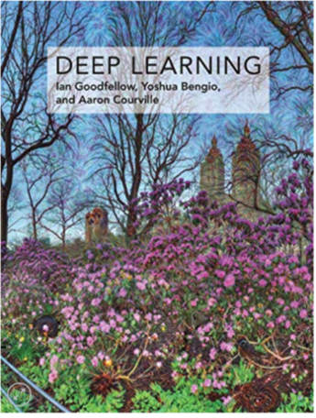
Reference
Deep Learning by Ian Goodfellow, Yoshua Bengio, and Aaron Curville

Slide 3
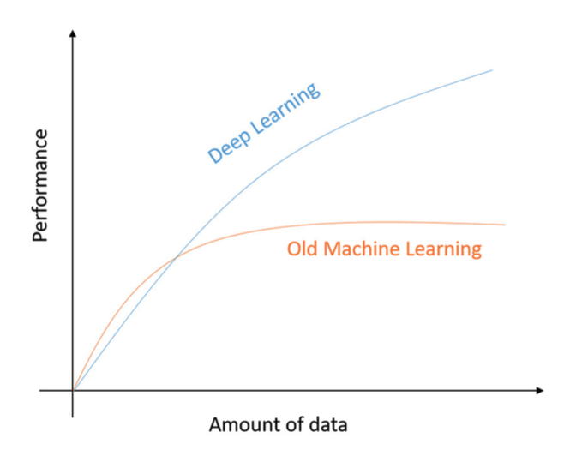
Why Deep Learning

Slide 4
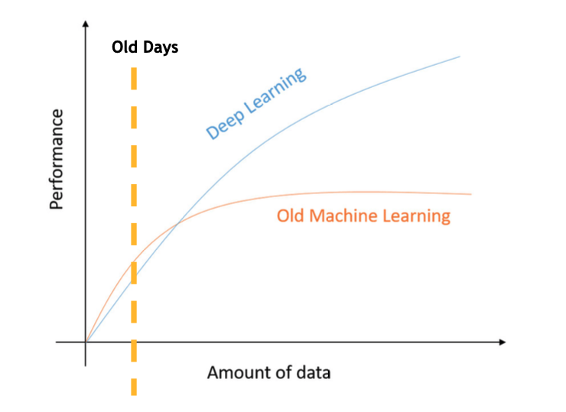
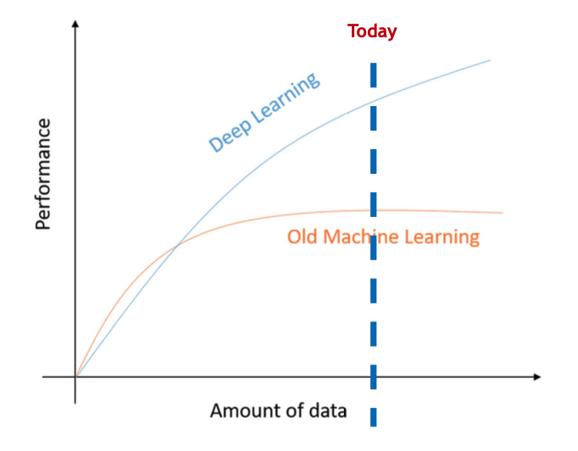
Why Deep Learning

Slide 5
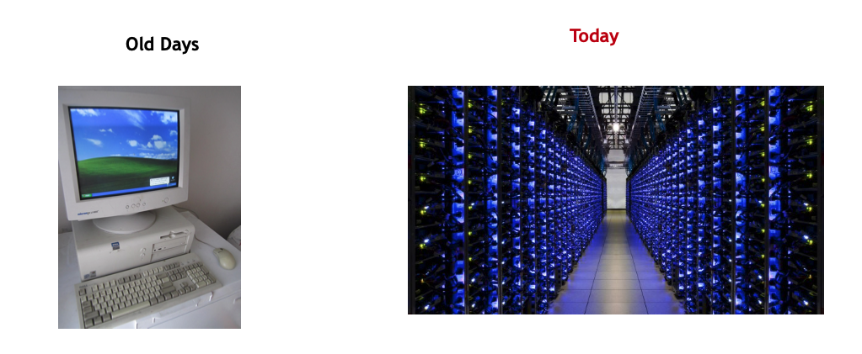
Why Deep Learning
Computational Power

Slide 6
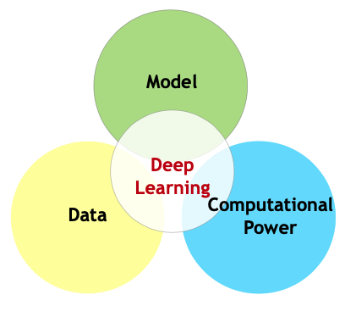
Why Deep Learning
Data + Model + Computational Power. = Success of Deep Learning!

Slide 7
Knowledge from Decades of Research
Perceptron [Rosenblatt, 1957]
Progress in the 1980s-1990s. Bengio, Hinton, Lecun (Turing Awards 2018)
Took off again (seriously) in after 2010+ because of…imageNet

Slide 8

Driven by Intuition and Empirical Success
Good research and progress based on solid intuition
Practice leads the way
Theory lags dramatically
no guarantees
little understanding of limitations
limited interpretability

Slide 9
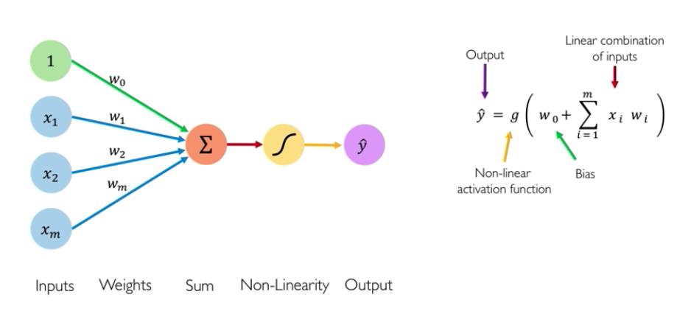
Perceptron: Building Block of DL

Slide 10
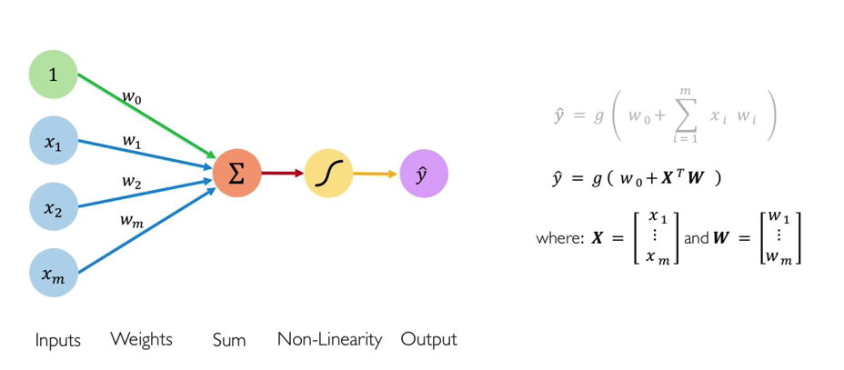
Perceptron: Building Block of DL

Slide 11
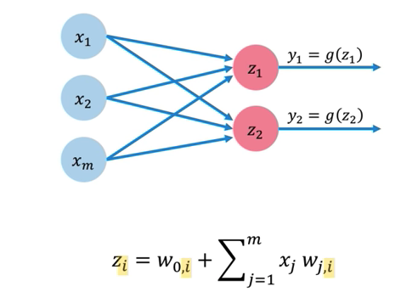
Building Neural Networks with Perceptron

Slide 12
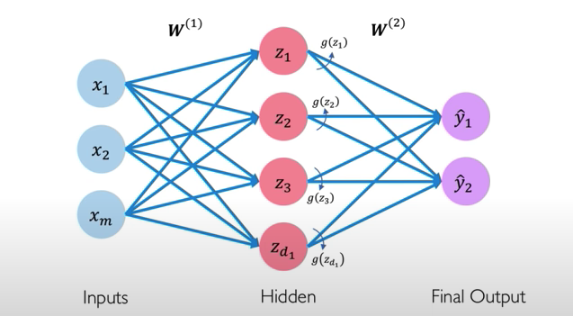
2-Layer Neural Network

Slide 13
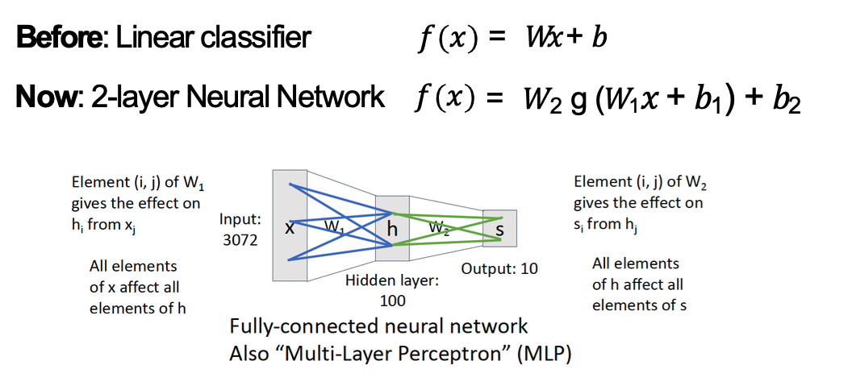
2-Layer Neural Network

Slide 14
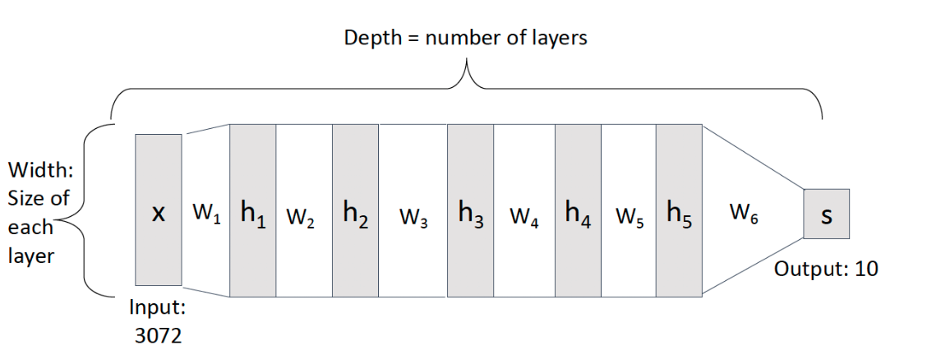
Deep Neural Networks

Slide 15
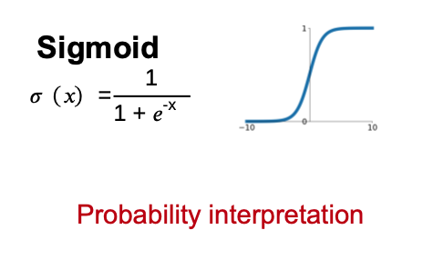
Activation Functions

Slide 16
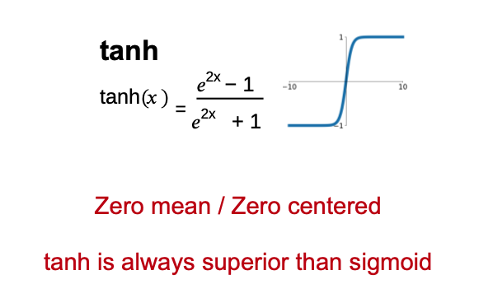
Activation Functions

Slide 17
Activation Functions
Drawbacks:
gradient is small, and thus training (SGD) is slow
Exp () is computationally expensive

Slide 18
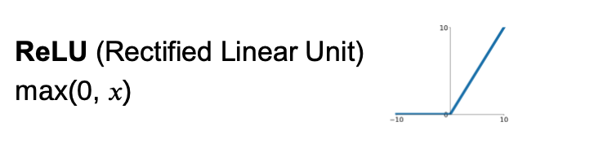
Activation Functions
Default choice of activation function, ReLU is a good default choice for most problems
Drawbacks:
Not zero centered.
Dead ReLU when x < 0

Slide 19
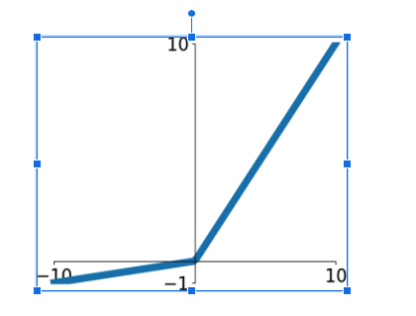
Activation Functions
Leaky ReLU
max (0.2𝑥, 𝑥)
Less used

Slide 20
What happens if we build a neural network with no non-linear activation function?

Slide 21
N linear classifiers = 1 linear classifier

Slide 22
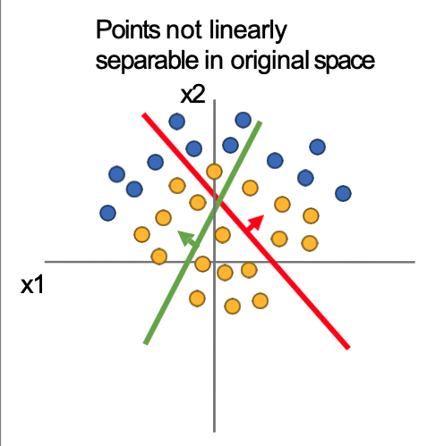
The Power of Activation function
Consider a linear transform:
h = Wx
Where x, h are both 2-dimensional

Slide 23
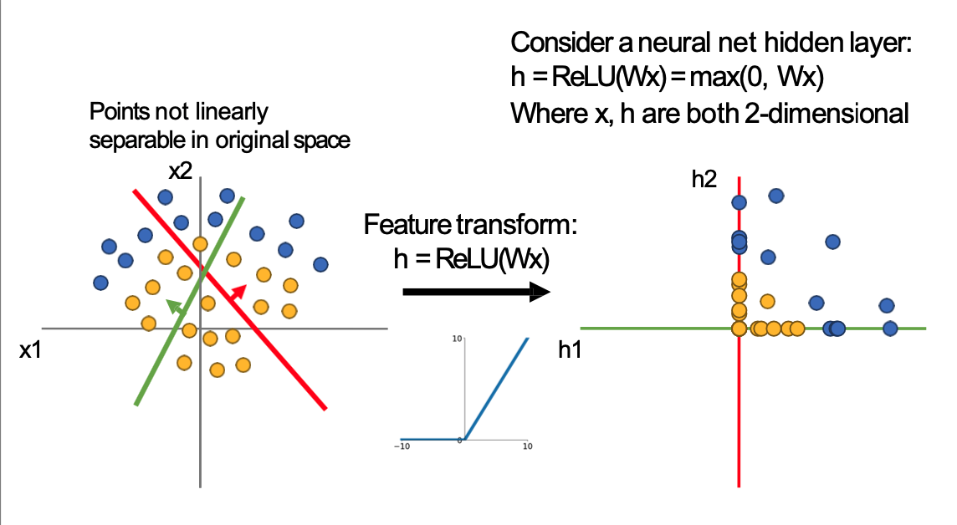

Slide 24
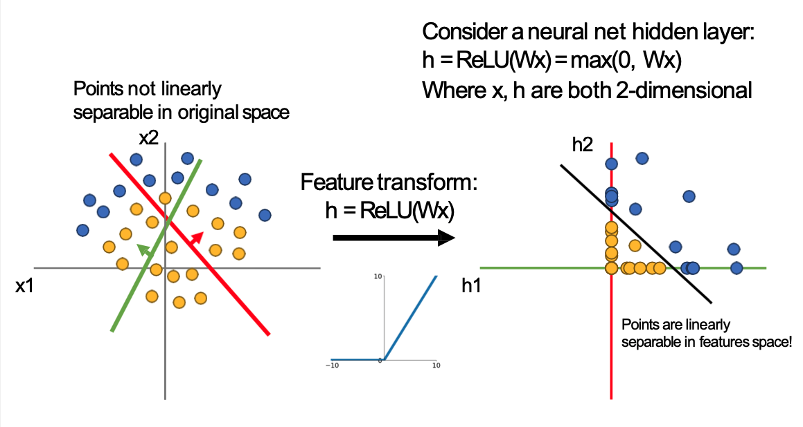

Slide 25












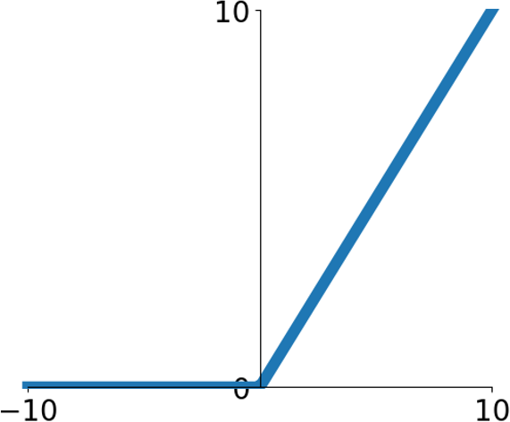
x2
h2
x1
h1
Points are linearly separable in features space!
Linear classifier in feature space gives nonlinear classifier in original space

Slide 26
ReLU: Rectified Linear Units

Slide 27
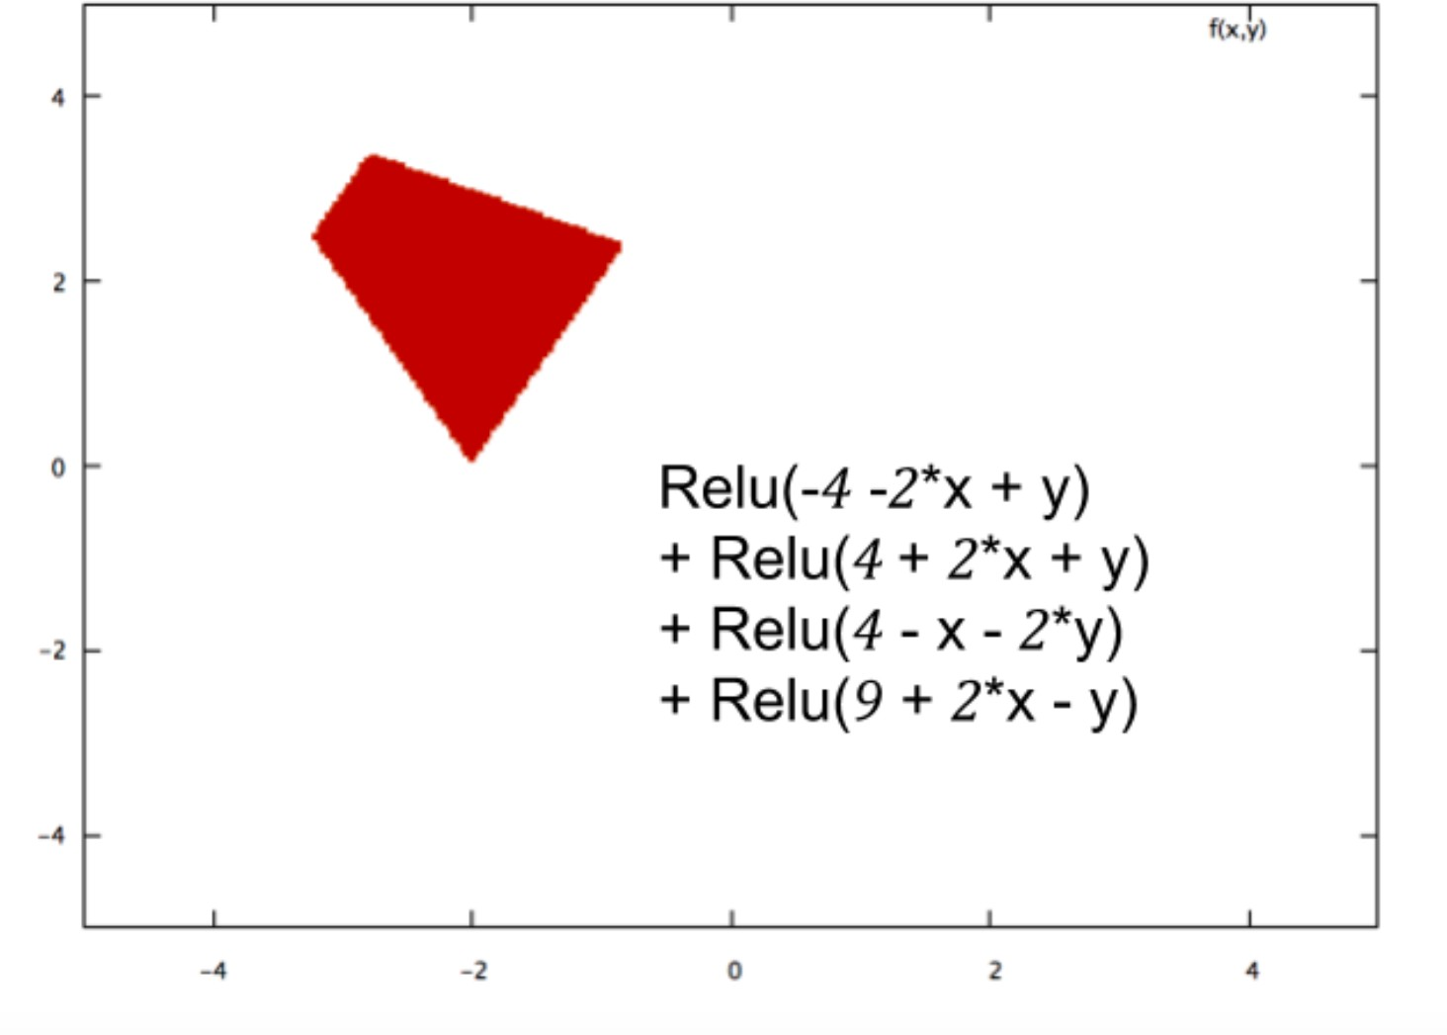
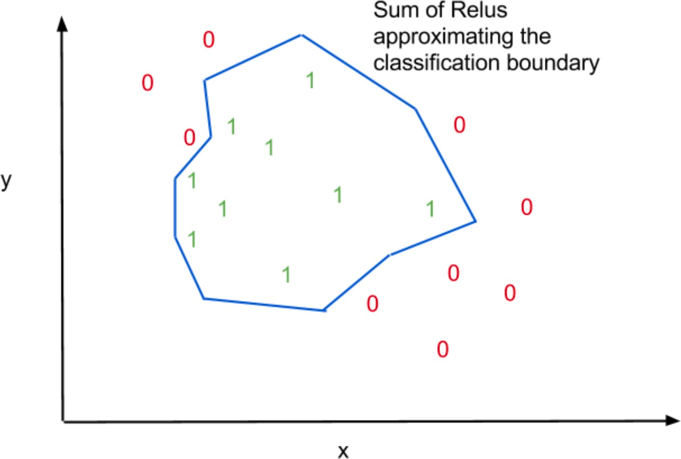

Slide 28
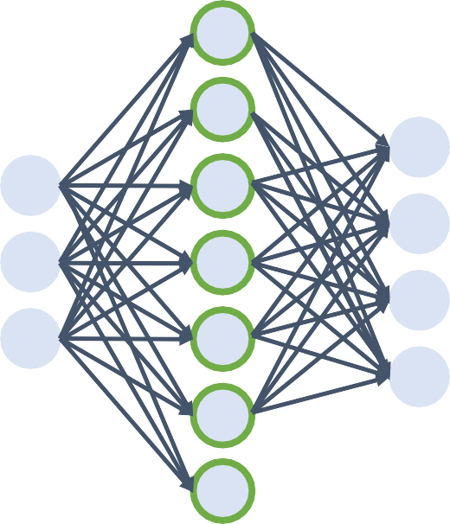
Universal Approximation
ŷ = w₂^{T}f(w₁^{T}x + b₁) + b₂
A simple FC-Non-Linearity network can approximate any function on a finite support, under:
mild assumptions
mild restrictions on non-linearity
First proven for Sigmoid by Cybenko 1989
Later extended for ReLU and other non-linearities

Slide 29
Universal Approximation
A simple FC-Non-Linearity network can approximate any function on a finite support, under:
mild assumptions
mild restrictions on non-linearity
Requires extremely large number of neurons in the FC layer
Hard to train
Computational infeasible
Theoretically possible

Slide 30
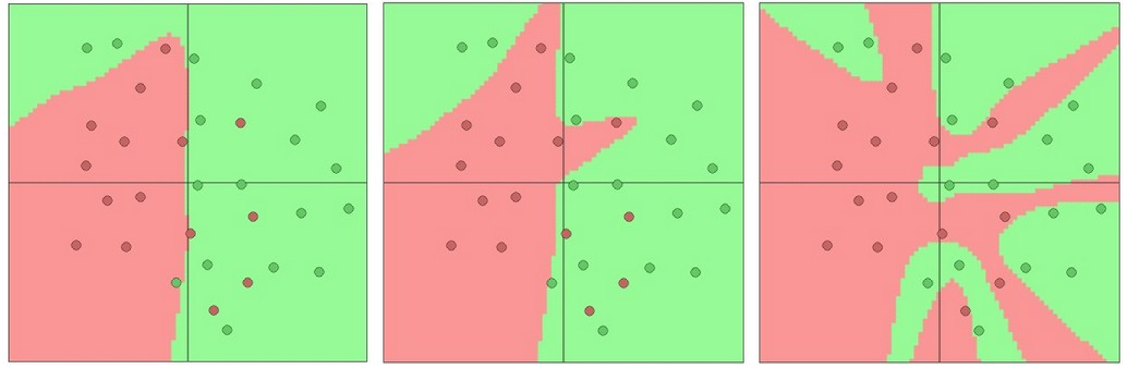
Setting the number of layers and their sizes
3 hidden neurons 6 hidden neurons 20 hidden neurons

Slide 31
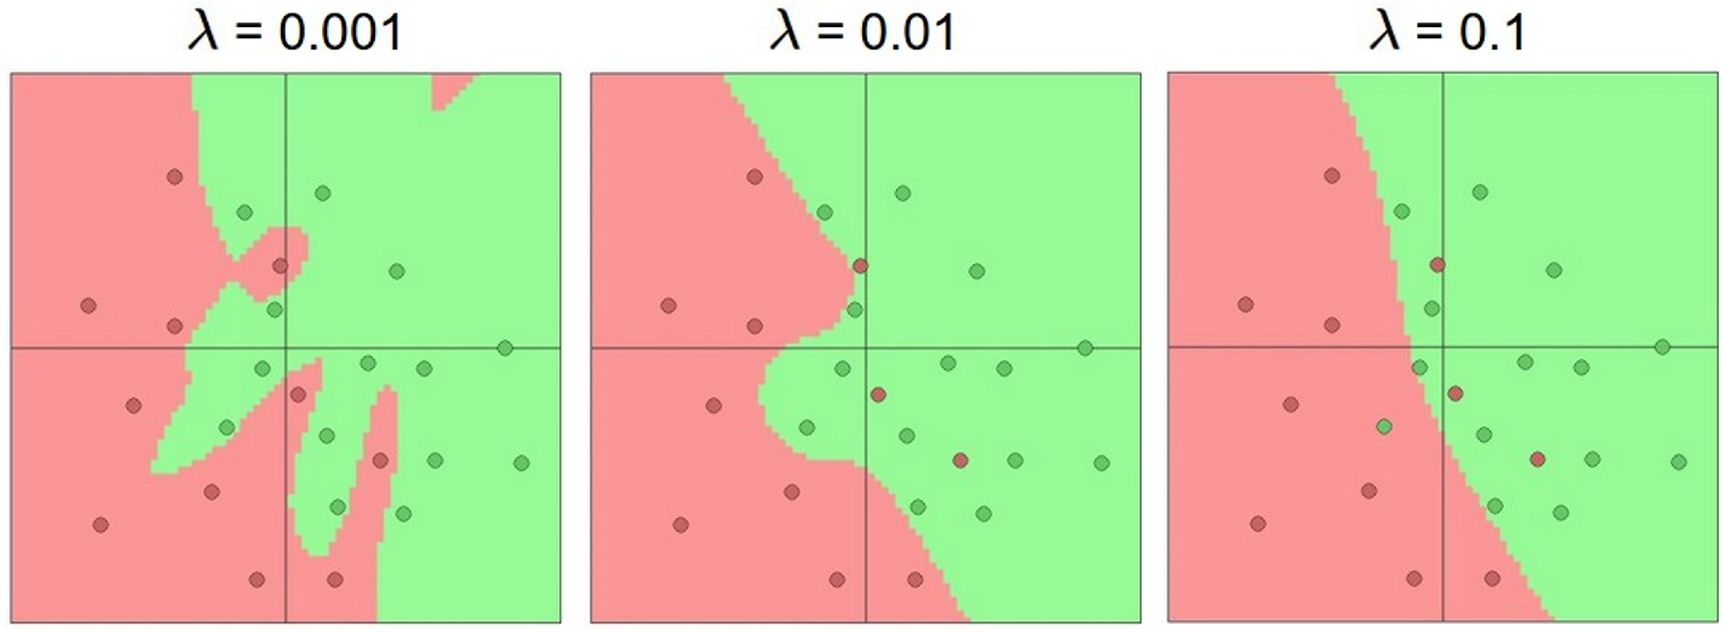
Don’t regularize with size; instead use stronger L2

Slide 32
Training Neural Network

Slide 33
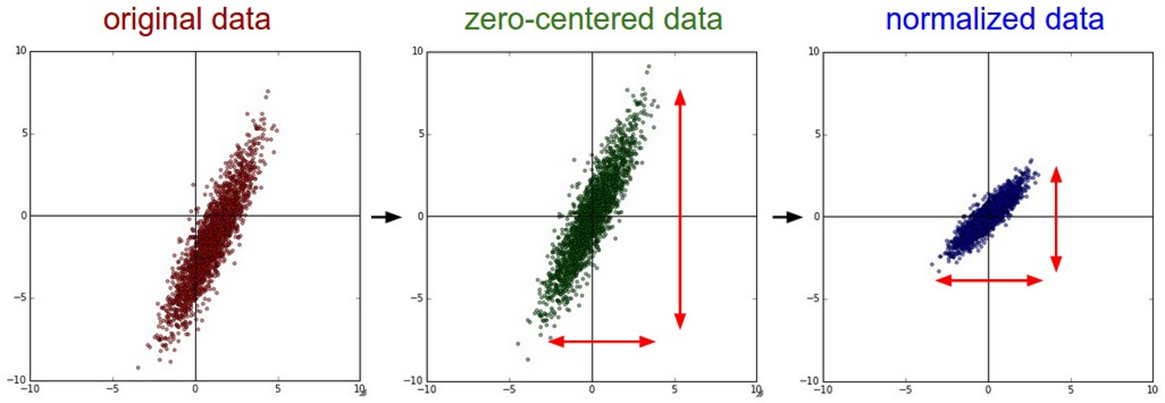
Data Preprocessing

Slide 34
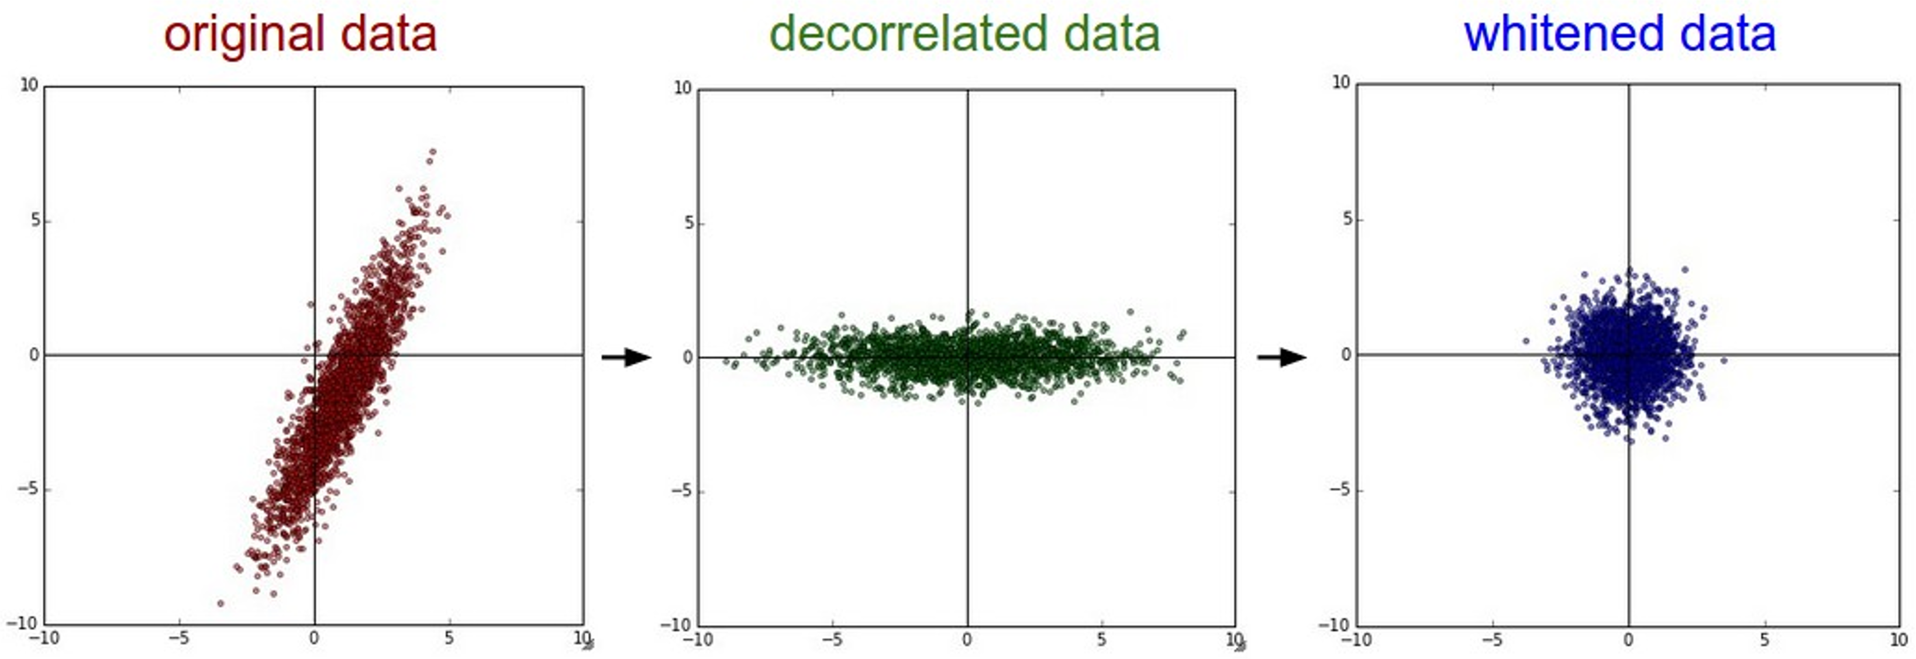
Data Preprocessing In practice, you may also PCA and Whitening of the data
(data has diagonal covariance matrix)
(covariance matrix is the identity matrix)

Slide 35



Data Preprocessing
Before normalization: classification loss very sensitive to changes in weight matrix; hard to optimize
After normalization: less sensitive to small changes in weights; easier to optimize

Slide 36
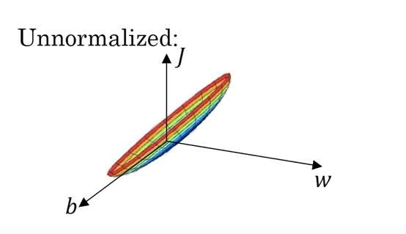
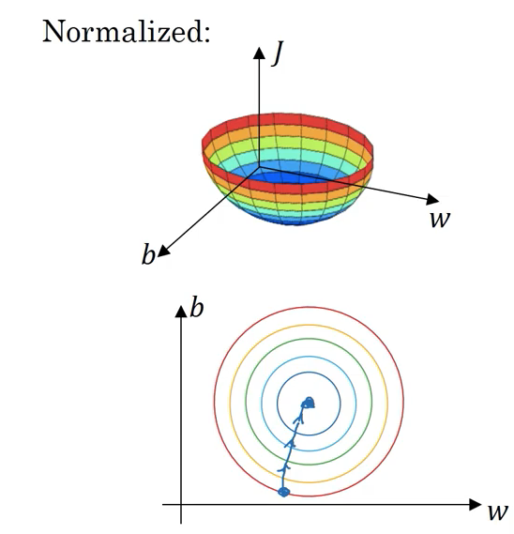
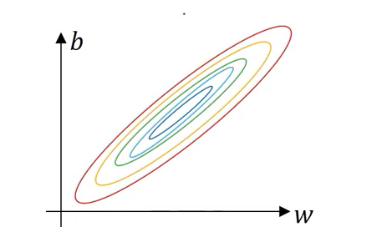
Data Preprocessing

Slide 37
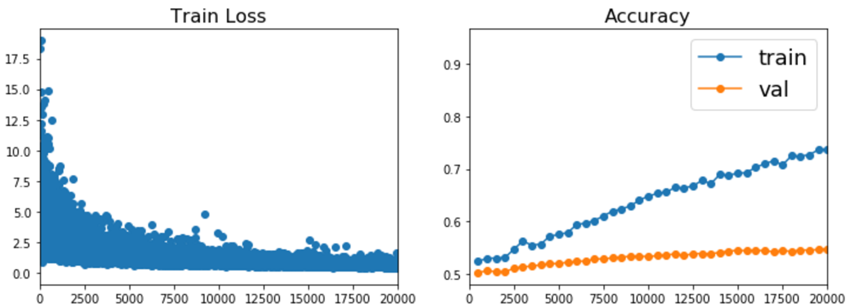
Regularization for Neural Networks

Slide 38
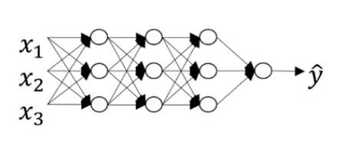
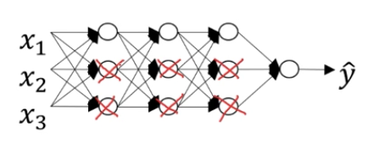
Regularization: Penalize complexity

Slide 39
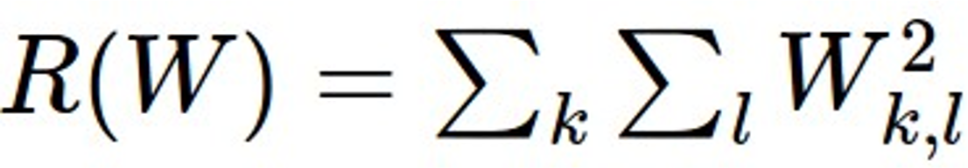
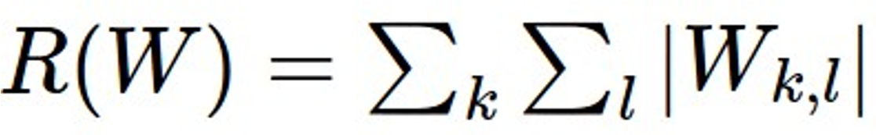
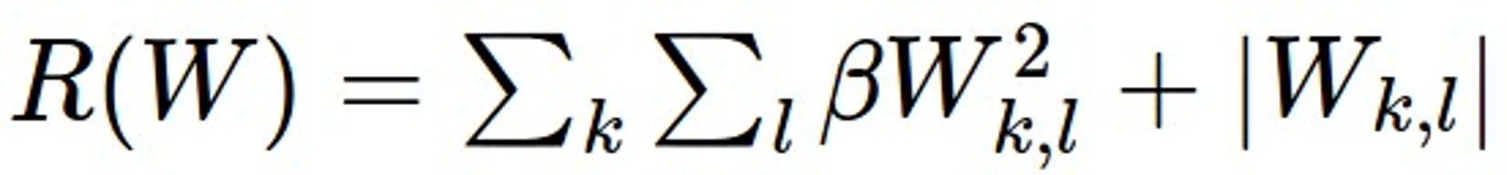
Regularization: Penalize complexity
In common use:
L2 regularization
L1 regularization
Elastic net (L1 + L2)
(Weight decay)

Slide 40
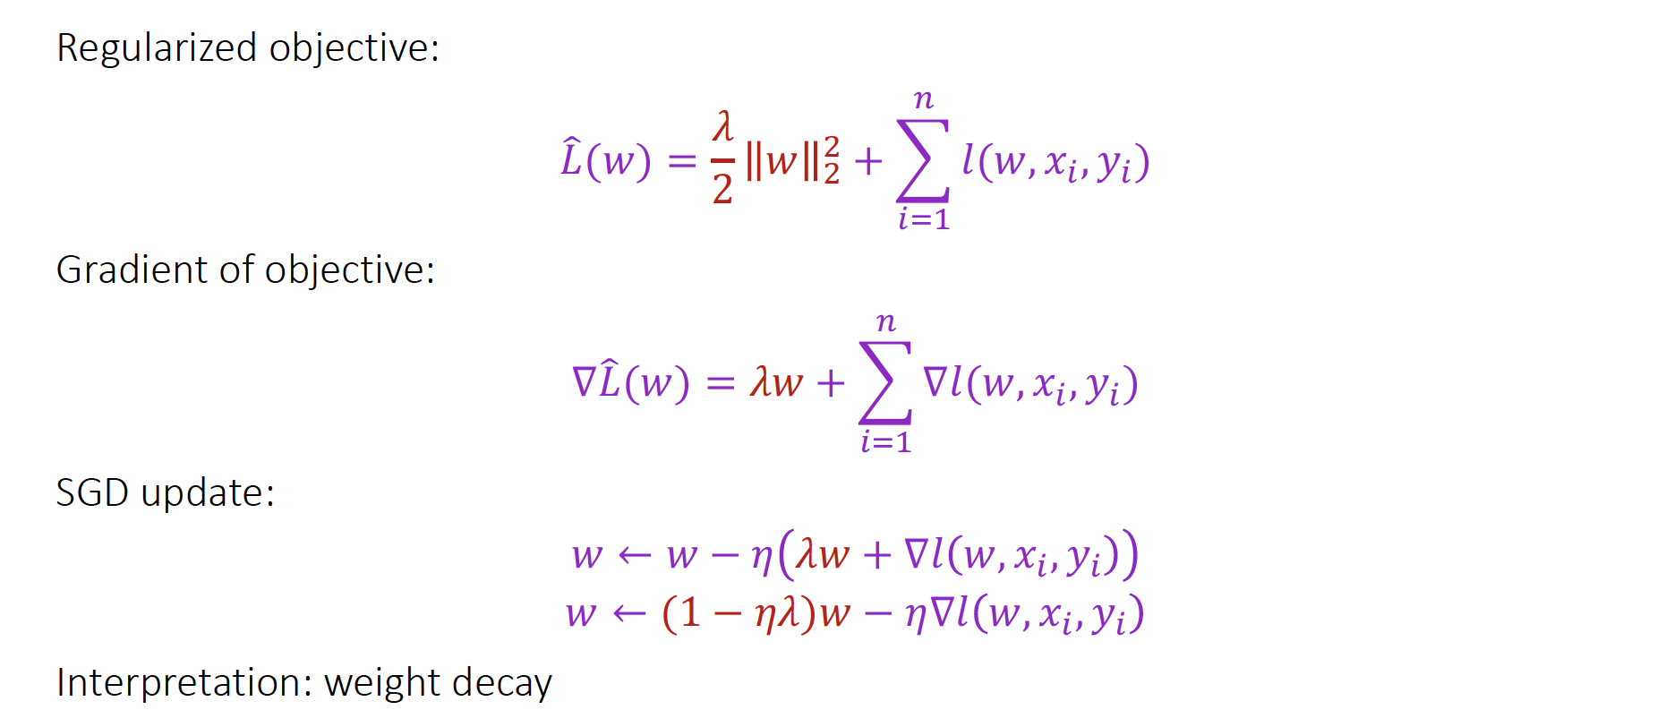
L2 Regularization

Slide 41
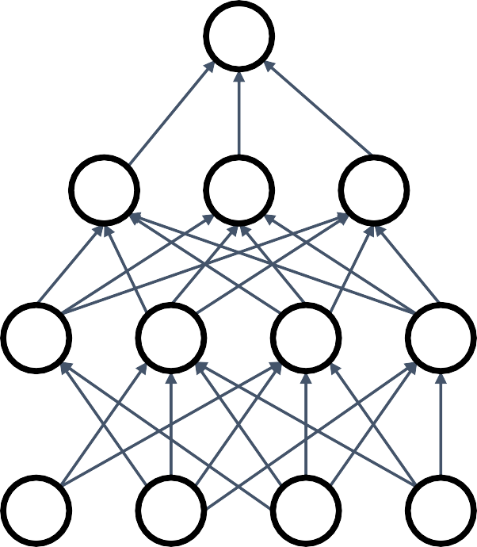



Regularization # 2: Dropout
In each forward pass, randomly set some neurons to zero Probability of dropping is a hyperparameter; 0.5 is common

Slide 42
Dropout
Interpretations:
#1: Can’t reply on any one feature. Spread out the weights, similar to L2 regularization.
#2: Dropout is training a large ensemble of models (that share parameters).

Slide 43
Regularization # 3: Data Augmentation
Increase size of your training data (‘augmentation’), by various transformations.

Slide 44
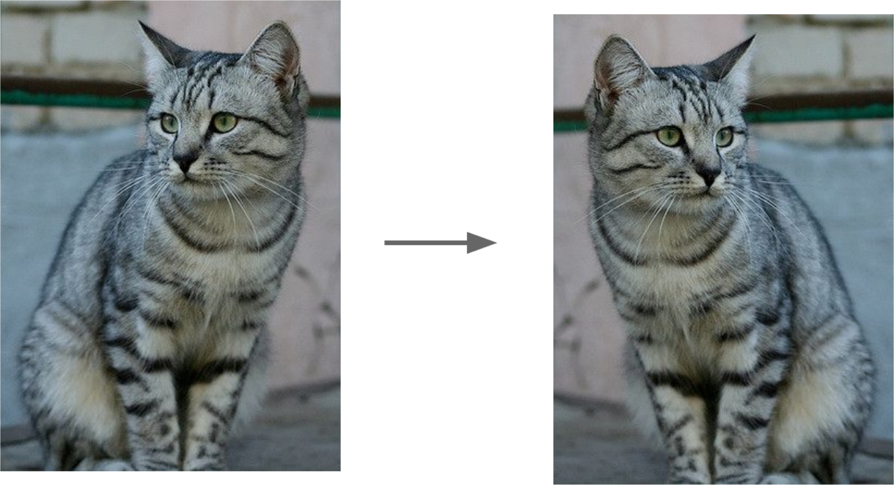
Data Augmentation
Increase size of your training data (‘augmentation’), by various transformations.
Horizontal flips

Slide 45
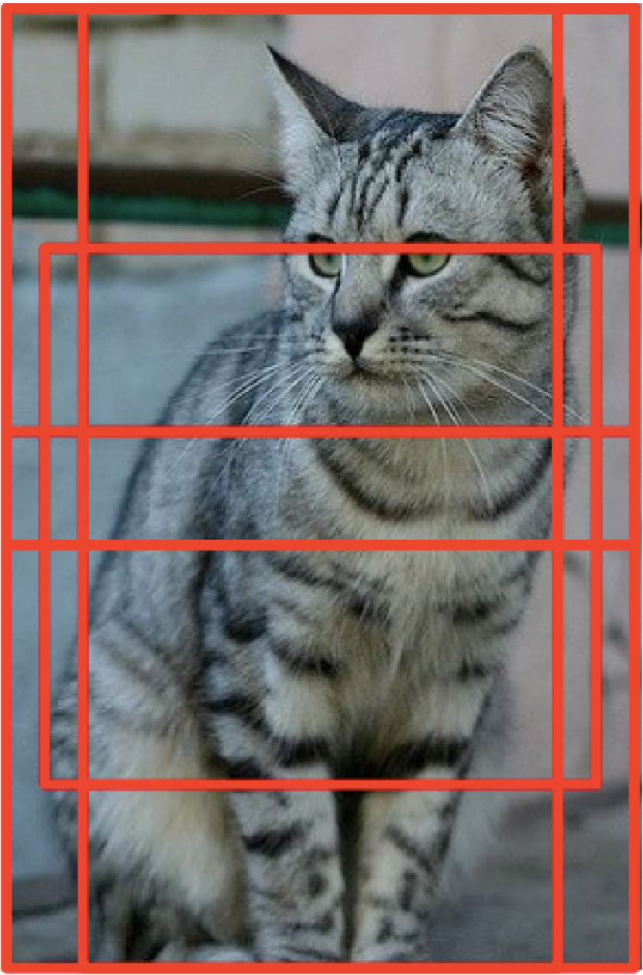
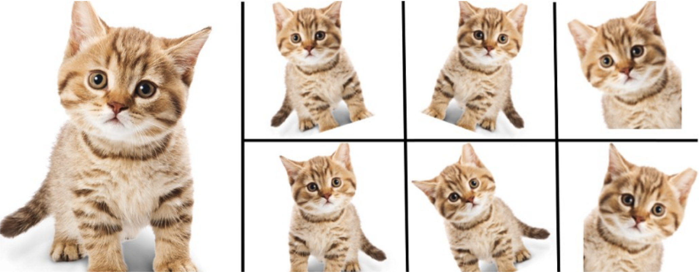
Data Augmentation
Increase size of your training data (‘augmentation’), by various transformations.
Horizontal flips
Rotation, shearing
Random crops

Slide 46
Data Augmentation
Increase size of your training data (‘augmentation’), by various transformations.
Horizontal flips
Rotation, shearing
Random crops

Slide 47
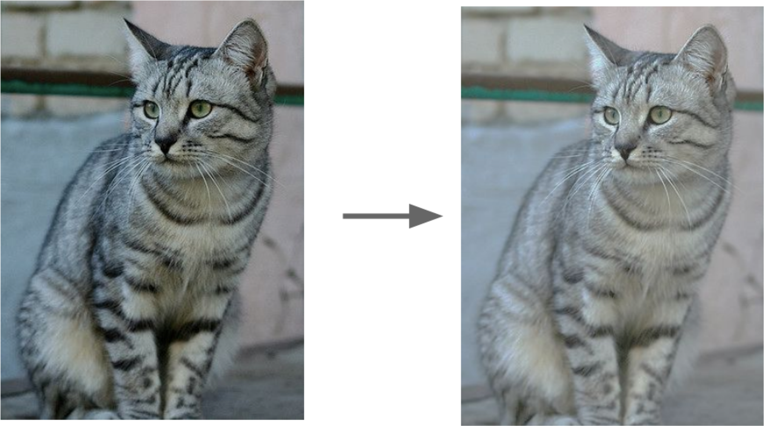
Data Augmentation
Increase size of your training data (‘augmentation’), by various transformations.
Geometric: flipping, rotation, shearing, random crops
Photometric: color transformations

Slide 48

Data Augmentation
Increase size of your training data (‘augmentation’), by various transformations.
Geometric: flipping, rotation, shearing, random crops
Photometric: color transformations
Other: add noise, compression artifacts, lens distortions, etc.

Slide 49
Convolutional Neural Network (CNN)

Slide 50

Problem: So far, our classifiers don’t respect the spatial structure of images
Stretch pixels into column
56
231
24
2
56 | 231
24 | 2
Input image (2, 2)
(4,1)

Slide 51
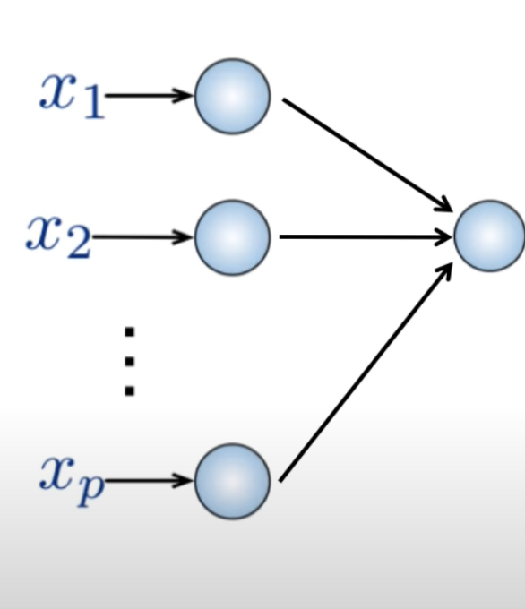
Problem: So far, our classifiers don’t respect the spatial structure of images
Connect neuron in hidden layer to all neurons in input layer
No spatial information!
And large amount of parameters
56
231
24
2
(4,1)

Slide 52
Problem: So far our classifiers don’t respect the spatial structure of images
Stretch pixels into column
56
231
24
2
56 | 231
24 | 2
Input image (2, 2)
(4,1)
Solution: Define new computational nodes that operate on images!

Slide 53
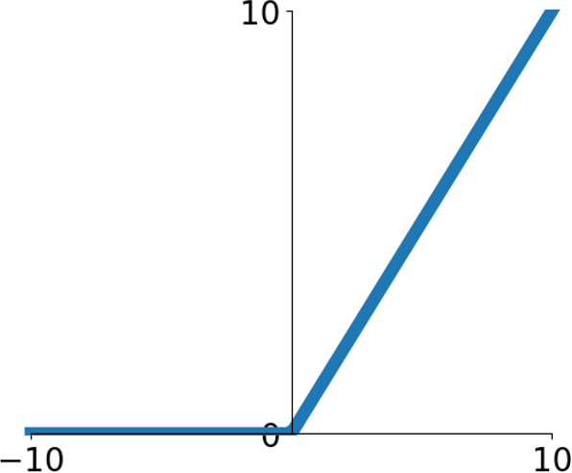
Components of a Fully-Connected Network
Fully-Connected Layers Activation Function
x
h
s

Slide 54
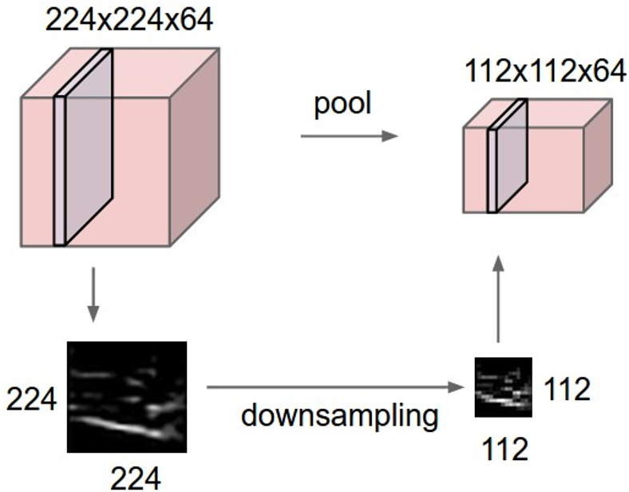

Components of a Convolutional Network
Fully-Connected Layers Activation Function
x
h
s
Convolution Layers
Pooling Layers
Batch Normalization
Layers

Slide 55
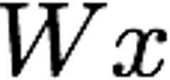

Fully-Connected Layer
32x32x3 image -> stretch to 3072 x 1
Input
Output
1
1
3072
10 x 3072
weights
10
1 number:
the result of taking a dot product between a row of W and the input (a 3072- dimensional dot product)

Slide 56
Convolution Layer
3x32x32 image: preserve spatial structure
32 height
32
width
3
depth / channels

Slide 57
Convolution Layer
3x32x32 image
3x5x5 filter
Convolve the filter with the image
i.e. “slide over the image spatially, computing dot products”
32 height
32
width
3
depth / channels

Slide 58
Convolution Layer
Filters always extend the full depth of the input volume
3x32x32 image
3x5x5 filter
Convolve the filter with the image
i.e. “slide over the image spatially, computing dot products”
32 height
32
width
3
depth / channels

Slide 59
Convolution Layer
3x32x32 image
3x5x5 filter
1 number:
the result of taking a dot product between the filter and a small 3x5x5 chunk of the image
(i.e. 3*5*5 = 75-dimensional dot product + bias)
𝑤!𝑥 + 𝑏
32
32
3

Slide 60
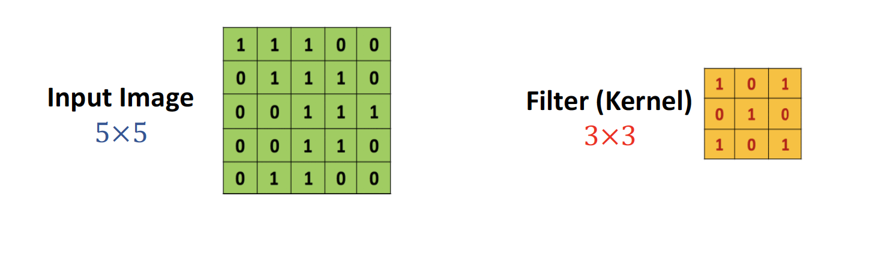
2D Convolution

Slide 61
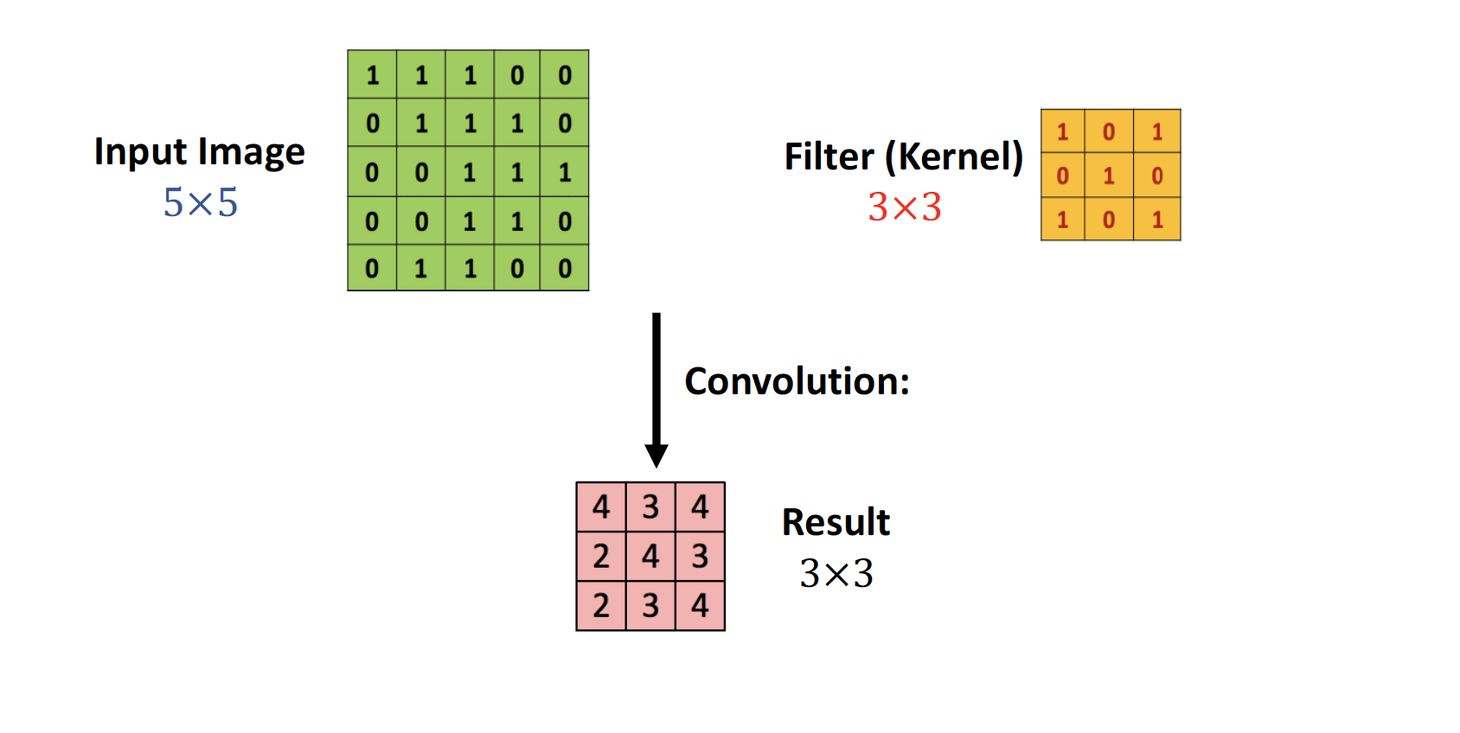
2D Convolution

Slide 62
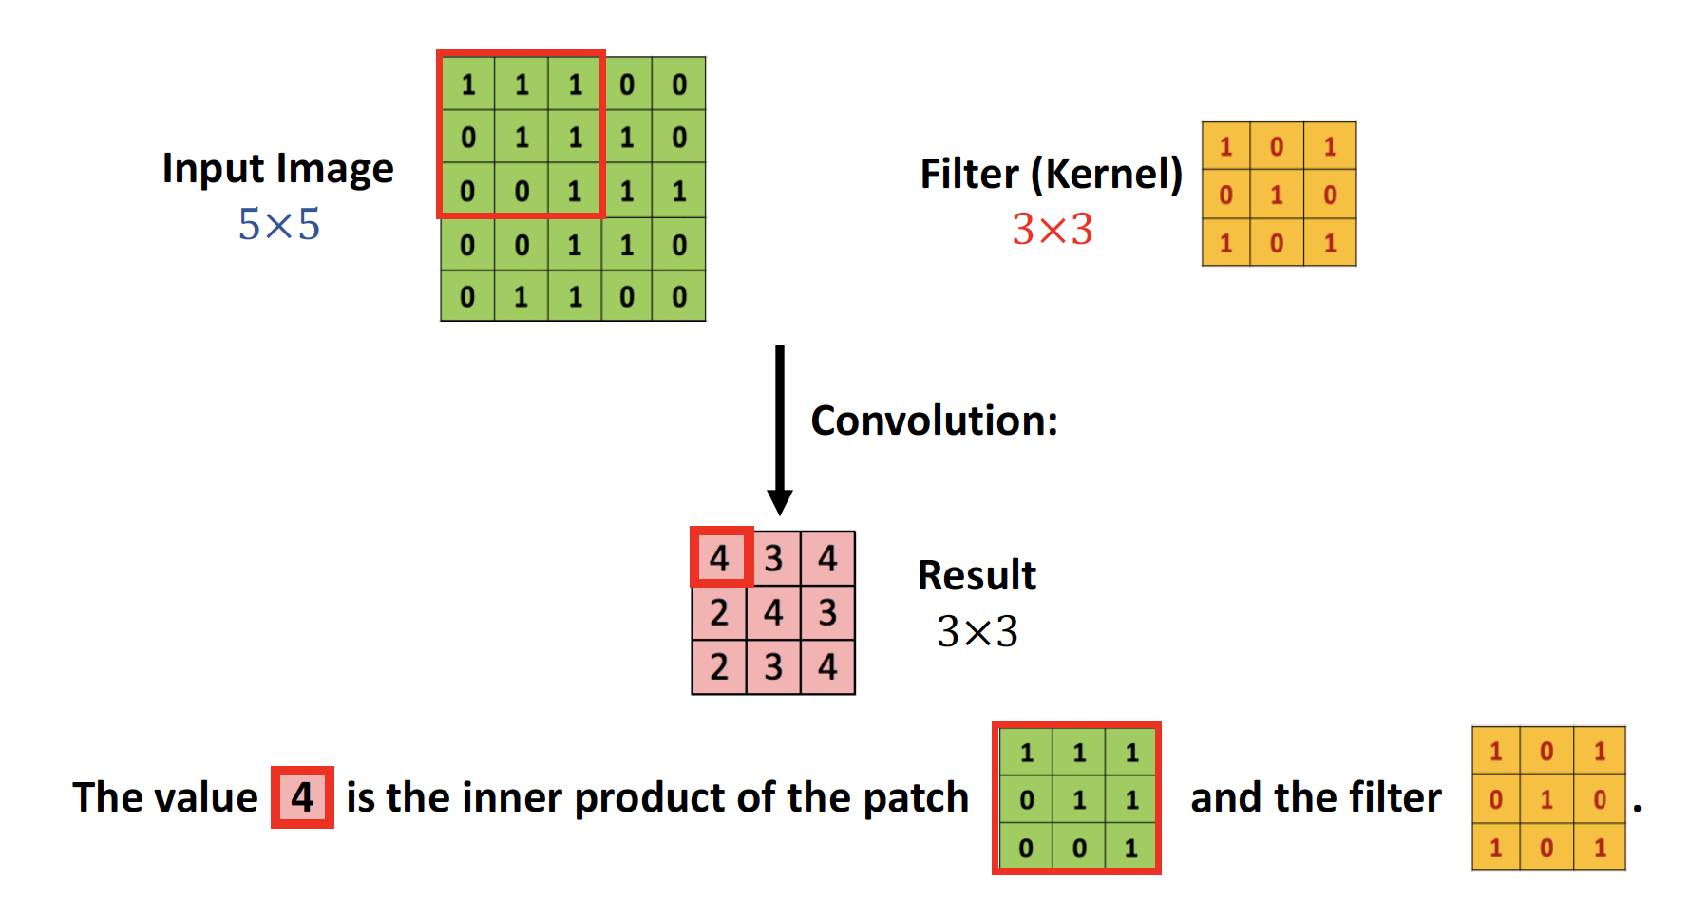
2D Convolution

Slide 63
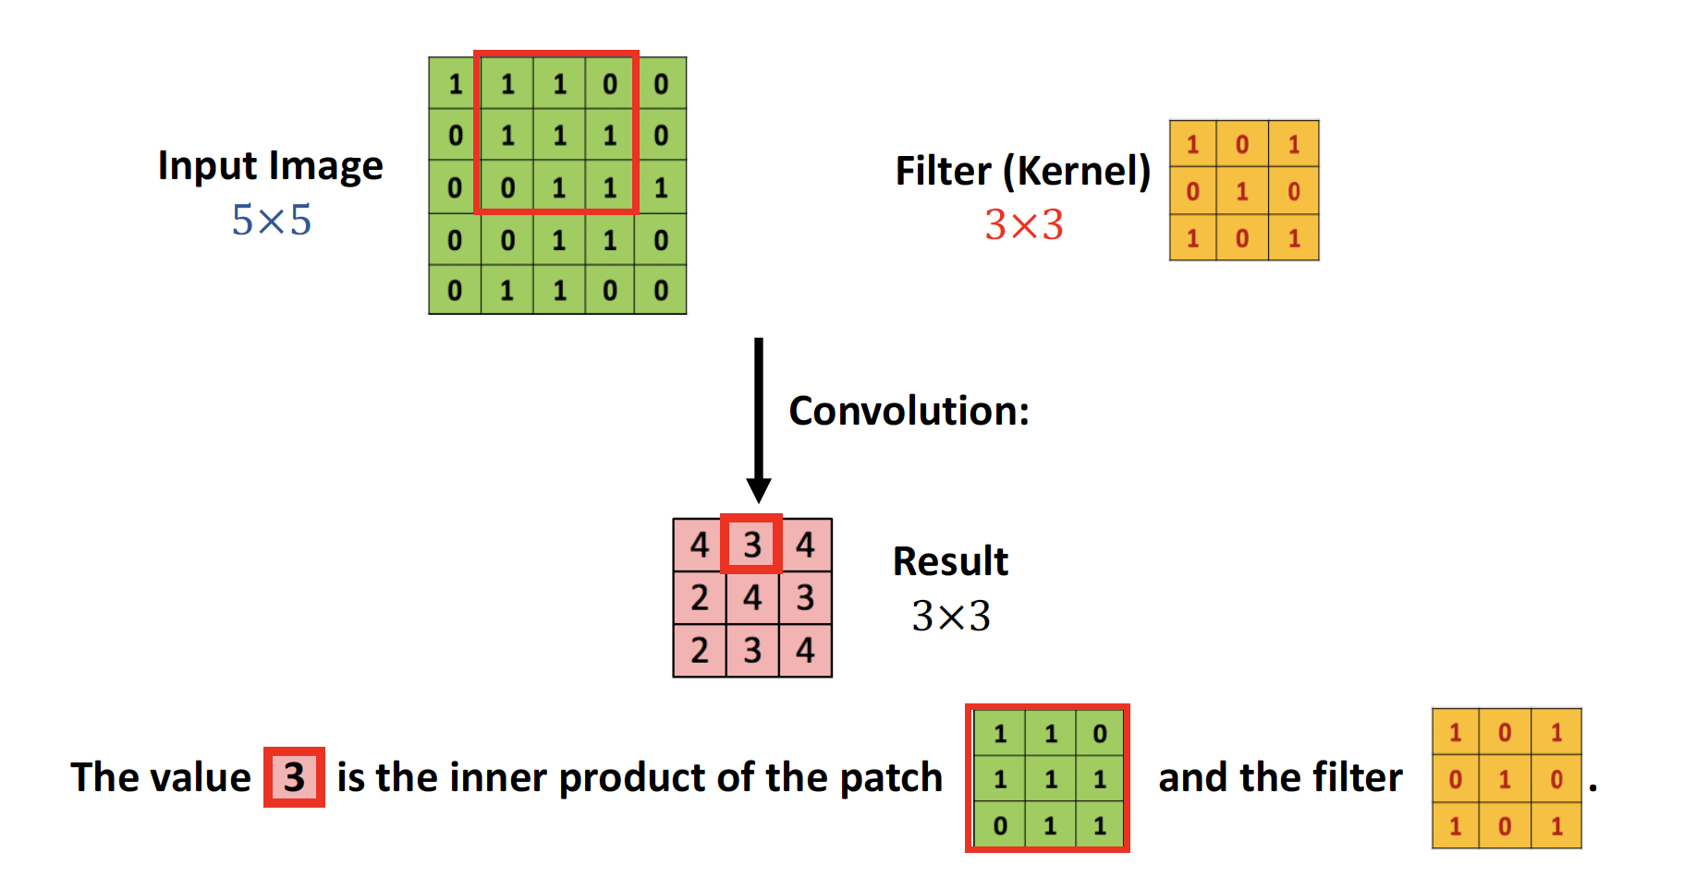
2D Convolution

Slide 64

2D Convolution

Slide 65
Convolution Layer
1x28x28
activation map
3x32x32 image
3x5x5 filter
28
convolve (slide) over all spatial locations
32
28
32
1
3

Slide 66
Convolution Layer
two 1x28x28 activation map
3x32x32 image
Consider repeating with a second (green) filter:
3x5x5 filter
28
convolve (slide) over all spatial locations
32
28
32
1 1
3

Slide 67
Convolution Layer
6 activation maps, each 1x28x28
3x32x32 image
Consider 6 filters, each 3x5x5
Convolution Layer
32
32
6x3x5x5 filters
Stack activations to get a 6x28x28 output image!
3

Slide 68
Convolution Layer
6 activation maps, each 1x28x28
3x32x32 image Also 6-dim bias vector:
Convolution Layer
32
32
6x3x5x5 filters
Stack activations to get a 6x28x28 output image!
3

Slide 69
Stacking Convolutions
Q: What happens if we stack two convolution layers?
A: We get another convolution!
Conv
Conv
Conv
….
Convolution is a linear operation!

Slide 70
Stacking Convolutions
Conv
ReLU
Conv
ReLU
Conv
ReLU
….

Slide 71

What do convolutional filters learn?

Slide 72
A closer look at spatial dimensions
Input: 7x7 Filter: 3x3
7
7

Slide 73
A closer look at spatial dimensions
Input: 7x7 Filter: 3x3
7
7

Slide 74
A closer look at spatial dimensions
Input: 7x7 Filter: 3x3
7
7

Slide 75
A closer look at spatial dimensions
Input: 7x7 Filter: 3x3
7
7

Slide 76
A closer look at spatial dimensions
Input: 7x7 Filter: 3x3 Output: 5x5
7
7

Slide 77
A closer look at spatial dimensions
Input: 7x7 Filter: 3x3 Output: 5x5
In general: Input: W
7
Filter: K
Output: W – K + 1
7
Problem: Feature maps “shrink” with each layer!

Slide 78

A closer look at spatial dimensions
Input: 7x7 Filter: 3x3 Output: 5x5
In general: Input: W
7
Filter: K
Output: W – K + 1
7

Slide 79
Zero Padding
0 | 0 | 0 | 0 | 0 | 0 | 0 | 0 | 0
0 |  |  |  |  |  |  |  | 0
0 |  |  |  |  |  |  |  | 0
0 |  |  |  |  |  |  |  | 0
0 |  |  |  |  |  |  |  | 0
0 |  |  |  |  |  |  |  | 0
0 |  |  |  |  |  |  |  | 0
0 |  |  |  |  |  |  |  | 0
0 | 0 | 0 | 0 | 0 | 0 | 0 | 0 | 0
Input: 7x7 Filter: 3x3 Output: 5x5
In general: Input: W
Filter: K
Output: W – K + 1
Solution: padding
Add zeros around the input

Slide 80

Zero Padding

Slide 81
Zero Padding
0 | 0 | 0 | 0 | 0 | 0 | 0 | 0 | 0
0 |  |  |  |  |  |  |  | 0
0 |  |  |  |  |  |  |  | 0
0 |  |  |  |  |  |  |  | 0
0 |  |  |  |  |  |  |  | 0
0 |  |  |  |  |  |  |  | 0
0 |  |  |  |  |  |  |  | 0
0 |  |  |  |  |  |  |  | 0
0 | 0 | 0 | 0 | 0 | 0 | 0 | 0 | 0
Input: 7x7 Filter: 3x3 Output: 5x5
In general: Input: W Filter: K Padding: P
Output: W – K + 1 + 2P
Very common:
Set P = (K – 1) / 2 to make output have same size as input!

Slide 82
Receptive Fields
For convolution with kernel size K, each element in the output depends on a K x K l o c a l receptive field in the input
Input
Output

Slide 83
Receptive Fields
Each successive convolution adds K – 1 to the receptive field size With L layers the receptive field size is 1 + L * (K – 1)
Input
Output
Be careful – ”receptive field in the input” vs “receptive field in the previous layer” Hopefully clear from context!

Slide 84
Receptive Fields
Each successive convolution adds K – 1 to the receptive field size With L layers the receptive field size is 1 + L * (K – 1)
Input
Problem: For large images we need many layers for each output to “see” the whole image image
Output

Slide 85
Receptive Fields
Each successive convolution adds K – 1 to the receptive field size With L layers the receptive field size is 1 + L * (K – 1)
Input
Problem: For large images we need many layers for each output to “see” the whole image image
Solution: Downsample inside the network
Output

Slide 86
Strided Convolution
Input: 7x7 Filter: 3x3 Stride: 2

Slide 87
Strided Convolution
Input: 7x7 Filter: 3x3 Stride: 2

Slide 88
Strided Convolution
Input: 7x7 Filter: 3x3 Stride: 2
Output: 3x3

Slide 89
Strided Convolution
Input: 7x7 Filter: 3x3 Stride: 2
In general: Input: W Filter: K Padding: P
Output: 3x3
Stride: S
Output: (W – K + 2P) / S + 1

Slide 90
1x1 Convolution
1x1 CONV
with 32 filters
(each filter has size 1x1x64, and performs a 64- dimensional dot product)
56
56
56
56
64
32

Slide 91
1x1 Convolution
1x1 CONV
with 32 filters
(each filter has size 1x1x64, and performs a 64- dimensional dot product)
Stacking 1x1 conv layers gives MLP operating on
56
56
56
56
64
32
each input position
Lin et al, “Network in Network”, ICLR 2014

Slide 92
Convolution Summary
Input: C_{i n} x H x W
Hyperparameters:
Kernel size: K_{H} x K_{W}
Number filters: C_{out}
Padding: P
Stride: S

Slide 93
Components of a Convolutional Network
Pooling Layers

Slide 94

Pooling Layers: Another way to downsample
64 x 224 x 224
64 x 112 x 112
Hyperparameters: Kernel Size
Stride
Pooling function

Slide 95

Max Pooling
64 x 224 x 224
Single depth slice
1 | 1 | 2 | 4
5 | 6 | 7 | 8
3 | 2 | 1 | 0
1 | 2 | 3 | 4
x
Max pooling with 2x2 kernel size and stride 2
6 | 8
3 | 4
Introduces invariance to small spatial shifts
No learnable parameters!

Slide 96
Pooling Summary
Input: C x H x W
Hyperparameters:
Kernel size: K
Stride: S
Pooling function (max, avg)
Output: C x H’ x W’
where
- H’ = (H – K) / S+1
- W’ = (W – K) / S + 1
Learnable parameters: None!

Slide 97

Convolutional Networks
Classic architecture: [Conv, ReLU, Pool ] x N, flatten, [ FC, ReLU] x N, FC
Example: LeNet-5
Lecun et al, “Gradient-based learning applied to document recognition”, 1998

Slide 98
Example: LeNet-5
Layer | Output Size | Weight Size
Input | 1 x 28 x 28
Conv (C_{out}=20, K=5, P=2, S=1) 20 x 28 x 28 20 x 1 x 5 x 5
ReLU 20 x 28 x 28
MaxPool(K=2, S=2) 20 x 14 x 14
Conv (C_{out}=50, K=5, P=2, S=1) 50 x 14 x 14 50 x 20 x 5 x 5
ReLU 50 x 14 x 14
MaxPool(K=2, S=2) 50 x 7 x 7
Flatten 2450
Linear (2450 -> 500) 500 2450 x 500
ReLU 500
Linear (500 -> 10) 10 500 x 10

Slide 99
Example: LeNet-5
Layer | Output Size | Weight Size
Input | 1 x 28 x 28
Conv (C_{out}=20, K=5, P=2, S=1) | 20 x 28 x 28 | 20 x 1 x 5 x 5
ReLU | 20 x 28 x 28
MaxPool(K=2, S=2) 20 x 14 x 14
Conv (C_{out}=50, K=5, P=2, S=1) 50 x 14 x 14 50 x 20 x 5 x 5
ReLU 50 x 14 x 14
MaxPool(K=2, S=2) 50 x 7 x 7
Flatten 2450
Linear (2450 -> 500) 500 2450 x 500
ReLU 500
Linear (500 -> 10) 10 500 x 10
Lecun et al, “Gradient-based learning applied to document recognition”, 1998

Slide 100
Example: LeNet-5
Layer | Output Size | Weight Size
Input | 1 x 28 x 28
Conv (C_{out}=20, K=5, P=2, S=1) | 20 x 28 x 28 | 20 x 1 x 5 x 5
ReLU | 20 x 28 x 28
MaxPool(K=2, S=2) | 20 x 14 x 14
Conv (C_{out}=50, K=5, P=2, S=1) 50 x 14 x 14 50 x 20 x 5 x 5
ReLU 50 x 14 x 14
MaxPool(K=2, S=2) 50 x 7 x 7
Flatten 2450
Linear (2450 -> 500) 500 2450 x 500
ReLU 500
Linear (500 -> 10) 10 500 x 10
Lecun et al, “Gradient-based learning applied to document recognition”, 1998

Slide 101
Example: LeNet-5
Layer | Output Size | Weight Size
Input | 1 x 28 x 28
Conv (C_{out}=20, K=5, P=2, S=1) | 20 x 28 x 28 | 20 x 1 x 5 x 5
ReLU | 20 x 28 x 28
MaxPool(K=2, S=2) | 20 x 14 x 14
Conv (C_{out}=50, K=5, P=2, S=1) | 50 x 14 x 14 | 50 x 20 x 5 x 5
ReLU | 50 x 14 x 14
MaxPool(K=2, S=2) 50 x 7 x 7
Flatten 2450
Linear (2450 -> 500) 500 2450 x 500
ReLU 500
Linear (500 -> 10) 10 500 x 10
Lecun et al, “Gradient-based learning applied to document recognition”, 1998

Slide 102
Example: LeNet-5
Layer | Output Size | Weight Size
Input | 1 x 28 x 28
Conv (C_{out}=20, K=5, P=2, S=1) | 20 x 28 x 28 | 20 x 1 x 5 x 5
ReLU | 20 x 28 x 28
MaxPool(K=2, S=2) | 20 x 14 x 14
Conv (C_{out}=50, K=5, P=2, S=1) | 50 x 14 x 14 | 50 x 20 x 5 x 5
ReLU | 50 x 14 x 14
MaxPool(K=2, S=2) | 50 x 7 x 7
Flatten 2450
Linear (2450 -> 500) 500 2450 x 500
ReLU 500
Linear (500 -> 10) 10 500 x 10
Lecun et al, “Gradient-based learning applied to document recognition”, 1998

Slide 103
Example: LeNet-5
Layer | Output Size | Weight Size
Input | 1 x 28 x 28
Conv (C_{out}=20, K=5, P=2, S=1) | 20 x 28 x 28 | 20 x 1 x 5 x 5
ReLU | 20 x 28 x 28
MaxPool(K=2, S=2) | 20 x 14 x 14
Conv (C_{out}=50, K=5, P=2, S=1) | 50 x 14 x 14 | 50 x 20 x 5 x 5
ReLU | 50 x 14 x 14
MaxPool(K=2, S=2) | 50 x 7 x 7
Flatten | 2450
Linear (2450 -> 500) 500 2450 x 500
ReLU 500
Linear (500 -> 10) 10 500 x 10
Lecun et al, “Gradient-based learning applied to document recognition”, 1998

Slide 104
Example: LeNet-5
Layer | Output Size | Weight Size
Input | 1 x 28 x 28
Conv (C_{out}=20, K=5, P=2, S=1) | 20 x 28 x 28 | 20 x 1 x 5 x 5
ReLU | 20 x 28 x 28
MaxPool(K=2, S=2) | 20 x 14 x 14
Conv (C_{out}=50, K=5, P=2, S=1) | 50 x 14 x 14 | 50 x 20 x 5 x 5
ReLU | 50 x 14 x 14
MaxPool(K=2, S=2) | 50 x 7 x 7
Flatten | 2450
Linear (2450 -> 500) | 500 | 2450 x 500
ReLU | 500
Linear (500 -> 10) 10 500 x 10
Lecun et al, “Gradient-based learning applied to document recognition”, 1998

Slide 105
Example: LeNet-5
Layer | Output Size | Weight Size
Input | 1 x 28 x 28
Conv (C_{out}=20, K=5, P=2, S=1) | 20 x 28 x 28 | 20 x 1 x 5 x 5
ReLU | 20 x 28 x 28
MaxPool(K=2, S=2) | 20 x 14 x 14
Conv (C_{out}=50, K=5, P=2, S=1) | 50 x 14 x 14 | 50 x 20 x 5 x 5
ReLU | 50 x 14 x 14
MaxPool(K=2, S=2) | 50 x 7 x 7
Flatten | 2450
Linear (2450 -> 500) | 500 | 2450 x 500
ReLU | 500
Linear (500 -> 10) | 10 | 500 x 10
Lecun et al, “Gradient-based learning applied to document recognition”, 1998

Slide 106
Example: LeNet-5
Layer | Output Size | Weight Size
Input | 1 x 28 x 28
Conv (C_{out}=20, K=5, P=2, S=1) | 20 x 28 x 28 | 20 x 1 x 5 x 5
ReLU | 20 x 28 x 28
MaxPool(K=2, S=2) | 20 x 14 x 14
Conv (C_{out}=50, K=5, P=2, S=1) | 50 x 14 x 14 | 50 x 20 x 5 x 5
ReLU | 50 x 14 x 14
MaxPool(K=2, S=2) | 50 x 7 x 7
Flatten | 2450
Linear (2450 -> 500) | 500 | 2450 x 500
ReLU | 500
Linear (500 -> 10) | 10 | 500 x 10
As we go through the network:
Spatial size decreases
(using pooling or strided conv)
Number of channels increases
(total “volume” is preserved!)
Lecun et al, “Gradient-based learning applied to document recognition”, 1998
Notes:
Q: why ReLU before MaxPool?

Slide 107

Hyperparameters for CNN

Slide 108
Batch Normalization

Slide 109
Batch Normalization
Recall: we do normalization for the input of the DNN.
Idea: “Normalize” the outputs of a layer so they have zero mean and unit variance.
Why? Helps speed up the training.

Slide 110

Batch Normalization

Slide 111

Batch Normalization: Standardization of Hidden Layers

Slide 112

Batch Normalization: Standardization of Hidden Layers

Slide 113

Batch Normalization: Standardization of Hidden Layers

Slide 114


Slide 115


Slide 116
Batch Normalization
FC
Usually inserted after Fully Connected or Convolutional layers, and before nonlinearity.
BN
tanh
FC
BN
tanh

Slide 117

Batch Normalization
Makes deep networks much easier to train!
Allows higher learning rates, faster convergence
Networks become more robust to initialization
Acts as regularization during training
Zero overhead at test-time: can be fused with conv!
FC
BN
tanh
FC
BN
tanh
ImageNet accuracy
Training iterations

Slide 118
Bonus Quiz
What happens if we build a neural network with no non-linear activation function?

